Slide 1
Your group plan at work
Securing your future with your group plan
Notes:
Welcome and thank you for taking the time to learn about the new Group Registered Retirement Savings Plan (RRSP), Deferred Profit Sharing Plan (DPSP) and Tax-Free Savings Account (TFSA) that is being offered to you through your employer and Sun Life.
This is a very valuable benefit, and we encourage you to take full advantage of it. The specific rules of the plan will be provided to you by your employer. This presentation will take approximately 20 minutes and will tell you what you need to know about the plan and how to enrol. Your employer will let you know if you are eligible to enrol in the DPSP.

Slide 2

Sources of Retirement Income
Notes:
Let’s start by talking about your role as a plan member and look at the sources of income you will have at retirement.

Slide 3
Your responsibilities under this plan
As a member of a group retirement savings plan with more than one investment option, you are responsible for:
Making sure you understand how your plan works.
Taking advantage of the information and tools available to make your investment decisions.
Taking advantage of the investment advisory services of a plan advisor if available.
Making actual investment decisions.
Determining how much you will contribute to your plan.
Checking to see how your investments are performing.
Revising your investment strategy if personal circumstances change.
Notes:
As a member of a group retirement savings plan with more than one investment option, you are responsible for the following:
- Making sure you understand how your plan works.
- Taking advantage of the information and tools available to make your investment decisions.
- Taking advantage of the investment advisory services of your plan advisor if available.
- Making your investment decisions.
- Determining how much you will contribute to your plan.
- Checking to see how your investments are performing.
- Revising your investment strategy if personal circumstances change.
And remember if you need any assistance, you can call Sun Life Client Care Centre.

Slide 4

Sources of retirement income
3
Personal
savings
2
Your company
retirement program
1
Government Retirement Benefits
Canada Pension Plan /
Quebec Pension Plan
Old Age Security
/ Quebec Pension Plan
Old Age Security
Notes:
Where is your retirement income going to come from? In most cases, Canadians need to replace between 60 and 80% of their pre-retirement income to maintain a similar lifestyle in retirement as they had before retirement. So, if you earned $40,000 just before you retired, you would aim to earn between $24,000 and $32,000 after you retire.
Saving for retirement requires a plan. Government benefits provide some income as a foundation, but the rest is up to you. The primary source of retirement income for many Canadians will be their company retirement plan. It is a very important benefit because it helps you accumulate savings and defer taxes.

Slide 5
Monthly maximum payments 2023
Government benefits
 | Canada Pension Plan* | Quebec Pension Plan* |  | Old Age Security**
Age 60 | $836.32 | $836.32 | Age 60 | $0
Age 65 | $1,306.75 | $1,306.75 | Age 65-74 | $687.56
Age 70 | $1,855.58 | $1,855.58 | Age 75 | $756.32
* Amounts based on earnings, length of employment history and rate of your contributions.
** If your income reaches a certain threshold you may be required to repay some of your Old Age Security benefits.
Notes:
Government benefits consist of the Canada Pension Plan (CPP) or Quebec Pension Plan (QPP), which all working individuals contribute to, and Old Age Security, or OAS, which is a non work-related pension paid to Canadians who meet certain age and residency requirements. Let’s take a look at the current year benefits – the chart divides them by age.
With the CPP or QPP, there is a maximum monthly pension payable at age 65 . This amount is indexed which means it rises each year as the cost of living increases.
If you’ve lived most of your life in Canada, starting at the age of eligibility, you will likely receive the maximum Old Age Security benefit. This benefit is also indexed, and increases each quarter based on cost of living increases. The age of eligibility for Old Age Security pension is 65.
These benefits are a good foundation for retirement income but if you need more it’s up to you to save.
The current maximums are shown on this slide. Depending on your situation you may not receive the maximum. You can consult your CPP or QPP statement for your own estimated payment at age 65. To request a copy of your Canada Pension Plan or Quebec Pension Plan statement, go online at Canada.ca and Retraitequebec.gouv.qc.ca.

Slide 6

The tax advantage of automatic payroll deductions
You get $100 for $75
 | Before RRSP Contribution | After RRSP Contribution
Gross pay | $ 1500 | $ 1500
Minus RRSP | $ 0 | $ 100
Taxable pay | $ 1500 | $ 1400
Tax @ 25%* | $ (375) | $ (350)
Net pay | $ 1125 | $ 1050
* Individual tax rates may vary.
Notes:
Contributing to this group RRSP through payroll deduction is an easy and convenient way to save. It also lowers your taxable income right away.
The amount of your contribution is deducted from your gross income before provincial and federal taxes are calculated.
Instead of giving money to the government in the form of taxes all year long (which allows them to collect interest on it), you benefit from it immediately!
In this example you can see that a $100 contribution into the RRSP only costs you $75 off your take-home pay.

Slide 7
RRSP Contribution limit
Lesser of 18%
of previous
years earnings
or $30,780
Unused
RRSP
Room (if any)
Prior
year’s
pension
adjustment
+
-
You are responsible for monitoring your personal RRSP limit as per your CRA Notice of Assessment
For more information about your personal limits visit Canada.ca
Year | CRA RRSP Limit
2022 | $29,210
2023 | $30,780
Notes:
7
To ensure you don’t over-contribute to your Group RRSP, be sure to refer to the ‘Notice of Assessment’ provided to you by Canada Revenue Agency, or CRA, after you filed your last income tax return. This form has your RRSP contribution limit for the current year.
You can see the current limits here. Unused RRSP room is carried forward indefinitely, so you might have more contribution room than you think.
Keep in mind that your employer and Sun Life do not monitor your allowable contribution limit. It is your responsibility to ensure you do not exceed your RRSP or TFSA contribution limits.

Slide 8
TFSA Contribution limit
This year’s
Contribution
limit
Unused
TFSA Room
(if any) from
prior years
Withdrawals
from prior
year
+
+
Year | CRA TFSA Limit
2022 | $6,000
2023 | $6,500
Notes:
8
The contribution limit for a Tax-Free Savings Account will be indexed to inflation and rounded to the nearest $500. These CRA limits apply to all TFSA accounts you may have.
Unused contribution room from prior years carries forward, and any withdrawals from your TFSA are added back to your contribution room on January 1 of the following calendar year.
Sign up for the CRA service called My Account to check your available TFSA contribution room for the year online at Canada.ca.

Slide 9
DPSP Contribution limit
There is no minimum required employer contribution
Maximum contribution is limited to lesser of 18% of your compensation for the year or the DPSP contribution limit
RRSP contribution room is reduced by the DPSP contributions received in the previous year
Year | CRA DPSP Limit
2022 | $15,390
2023 | $15,780
Notes:
9
Your employer will tell you if they are contributing to the DPSP on your behalf. There is no minimum required employer contribution for a DPSP. The maximum contribution allowed to a DPSP is the lesser of 18% of your compensation for the year or the DPSP contribution limit.
Contributions to the DPSP are reported by your company each year on your T4 slip as a pension adjustment and will affect your RRSP contribution room for the following year.

Slide 10
Choice of three accounts
Group RRSP | DPSP | TFSA
Tax-deductible savings Tax-sheltered earnings Contribute up to RRSP limit Withdrawals are subject to withholding tax Ideal for retirement savings | Employer shares profits by contributing to DPSP on behalf of each employee* No minimum employer contribution required Tax-sheltered earnings Contribute up to DPSP limit Withdrawals are subject to withholding tax Ideal for retirement savings * Based on eligibility | No tax-deductibility, but tax sheltering Contribute up to TFSA limit Tax-free withdrawals Withdrawals increase contribution room in the following calendar year Ideal for any savings goal
Notes:
Now let’s look at the places you can direct your contributions in your company plan. You decide if you would like to participate in the Group RRSP or the TFSA, or both.
Your employer will tell you if you are eligible to enrol in the DPSP and whether they are contributing to the DPSP on your behalf.
The Group RRSP offers the benefit of saving on the income taxes you pay. Using pre-tax payroll deduction contributions, you get an immediate tax break every time you contribute. You can contribute up to your RRSP limit each year. With earnings and contributions fully tax-sheltered until withdrawn, this is an ideal way to save for retirement.
The DPSP allows your employer to share profits with you by making contributions to your DPSP account. There is no minimum required employer contribution for a DPSP. With earnings and contributions fully tax-sheltered until withdrawn, this is another great way to save for retirement.
In the Group Tax-Free Savings Account, you contribute after-tax dollars. While you don’t get an upfront tax deduction, you never pay Canadian tax on the investment earnings in your account* and all withdrawals are completely tax-free. A TFSA gives you complete flexibility to use your savings for any short-, medium-, or long-term goal – cars, down payment on a home, vacations, education, or retirement. The choice is yours!
You can re-contribute any withdrawn amounts in a ‘subsequent year’. A caution: If you re-contribute in the same year of withdrawal, you may find yourself in an over-contribution position.
* Note: Foreign tax may apply on certain foreign income.

Slide 11

Investing details
Notes:
As a member of a group plan, you will have access to a range of different investment options. In this section we will take a closer look at what they are.

Slide 12
Understand Risk vs. Return
Guaranteed
Guaranteed interest during fixed term
Less long-term growth potential
Canadian, US, Global &
International Equities
High
Bonds (Fixed Income)
Promise to repay debt
Pays a rate of interest
Government and corporate
Balanced
Return
Equities (Stocks)
Share in company profits
Canadian, U.S., Global & International
Greater long-term growth potential
Bonds
Balanced
Mix of cash, bonds and equities
Automatic diversification
Low
Guaranteed Funds
Low
Risk
High
Notes:
Investment Risk is often defined as the volatility of returns on an investment. Since certain asset classes can have diverse returns year by year, day by day, or even hour by hour, you need to establish your ability to withstand the volatility of your investments. One of the main principles of investing is that in order to achieve higher returns, you will need to take on more risk. This chart shows the relationship between investment risk and return. Let’s take a look at the different asset classes – starting with Guaranteed funds.
These funds are not suitable for long term investing, as the returns you earn are low. Over the long term, they may not be able to keep pace with the inflation rate.
Next, we have bond funds. Bond funds fluctuate in value compared to guaranteed funds, increasing the level of investment risk. Bonds have 2 types of risks associated with them. The first type is credit risk or default risk.
Bonds are loans so there is a chance that the government or company will not be able to pay your principle back. The second type of risk is interest rate risk. Interest rates have an inverse relationship with bond prices – when interest rates rise, bond prices fall. When interest rates fall, bond prices rise.
Balanced funds fluctuate in value and have a higher level of investment risk than bond funds, but lower than equity funds. The potential for return on these funds is higher than that of bond funds and lower than that of equity funds.
Equities are considered to be the most volatile investment option to invest in as they are subject to market risk. Market risk is not knowing what is going to happen in the marketplace – events like the Tech Bubble in 2000, 9/11 in 2001 or the credit crisis in 2008 are good examples. Even though equity funds fluctuate more than other investment options, they offer the greatest potential for long term growth.

Slide 13
Wide range of investment options
Let me do it
(formerly Built BY me) -
Choose your own portfolio from the following asset categories:
Help me do it
(formerly Built FOR me) -
“pre-built” portfolio funds
Guaranteed Funds
(1, 3, 5 year)
Guaranteed Daily Interest Account
Fixed Income
Canadian Equity
U.S. Equity
International Equity
Global Equity
Real Assets
Granite Target Date Funds
Notes:
You can decide to build your own investment mix, by picking from a menu of investment funds or you can choose a pre-built portfolio. You can change your selection at any time by contacting Sun Life.
With the pre-built portfolio options you are directed to a single fund that’s designed to be a one-stop investment solution. For example, the Granite Target Date funds are structured to coincide with a key life event such as retirement and have a portfolio asset mix that adjusts automatically as you get closer to your goal.
When you first enrol in the plan you will be automatically invested in the Granite Target Date Funds for the RRSP and DPSP, and a bond fund for the TFSA. At any point after this, you may change your investments if you choose.

Slide 14

Granite Funds™ – Target Date
When do you need the money?
Pre-built solutions – with an asset mix that changes over the life of the fund
Managers were selected who have:
  Superior long-term performance
  Expertise in their asset classes or investment styles
Low cost multi-manager target date funds
Notes:
The Granite Target Date Funds are designed to align with differing life stages based on the length of time until retirement.
Granite Target Date Funds offer a mix of different fund managers who have shown superior performance over the long-term and who have proven expertise in their asset class or investment style.
The funds focus on a target retirement or maturity date with an asset mix that changes automatically throughout the life of each fund. As the fund draws closer to maturity (or the date of the fund), higher risk investments, such as equities, will decrease and the lower risk investments, such as fixed income, will increase.
Your RRSP and DPSP investments will initially be invested in the Sun Life Granite Target Date Fund that matures just prior to your 65th birthday.
For example:
If you are a plan member who expects to retire in 2038, you would invest in the 2035 Granite Target Date Fund. This is the target date fund with a maturity date occurring just prior to your expected retirement date.

Slide 15
The importance of diversification
You should always be diversified in your approach
to investing.
  Investment Style
  Growth and value, active and passive fund managers
  Asset class
  Cash equivalents, fixed income and equities
  Geographic region
  Canadian, U.S. and International equities
  Currency
  Limit exposure to U.S. currency risk
Notes:
No one investment style, asset class or geographic region consistently out-performs year after year.
Diversification means:
Lowering your overall investment risk by investing in a variety of:
Asset classes, such as guaranteed funds, bonds and equities
Management styles,
As well as different countries or regions
Choosing a variety of investments can reduce your risk of loss and increase your potential for higher investment returns. Diversifying your portfolio by different fund categories, referred to as an "asset allocation" strategy, is a key part of your investment decision.

Slide 16

Communication & Technology
Notes:
As a member of a SunAdvantage my savings Group RRSP, DPSP and TFSA, you can access your account in many ways. These include mysunlife.ca, the toll-free Sun Life Client Care Centre and account statements. Let’s discuss each of these in more detail.

Slide 17
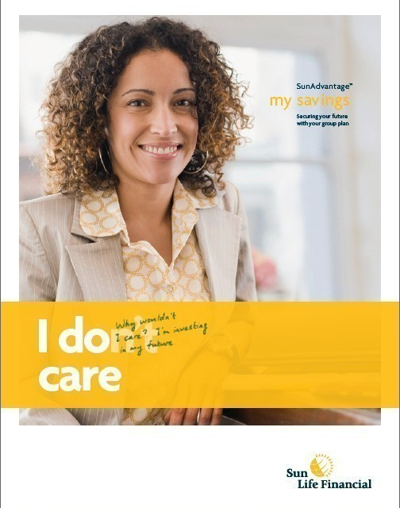

Client Care Centre
Toll-free line 1-877-SUN-LIFE
Perform transactions 24 hours a day through the Automated Telephone System
Client Care Centre representatives available 8 a.m. to 8 p.m. ET any business day
  Operate live in 189 languages
Notes:
The Sun Life Client Care Centre number is 1-877-SUN-LIFE. It provides 24-hour automated phone account access and live Representatives available from 8 am to 8 pm ET. Close to 200 languages are supported. The Client Care Centre provides support and processing of your questions, account changes, fund changes, website assistance as well as information on the investment options you have available to you. Fees may be charged for certain transactions.

Slide 18
Plan member services website
mysunlife.ca
Fund and account balances
Summary of contributions
Move money between funds
View tax slips and receipts
Access historical fund performance information
Update your future investment instructions
Update your beneficiary
Lump sum contributions
Newsletters
View historical account statements
Convenient, Quick, Easy
Notes:
Sun Life’s Plan Member website is mysunlife.ca. Your account will be set up within 10 business days from the receipt of your enrolment form by Sun Life. The website allows you to transact in your account, learn about retirement, and view investment research.
Highlights include:
Viewing your investments and account balances
Getting a summary of all your contributions
Moving money between funds
Viewing tax slips and receipts
Accessing fund performance information
Updating your future investment instructions
Updating your beneficiary
Making lump sum contributions
Reading newsletters
And viewing your past account statements

Slide 19

Plan member services website continued
Complete the Asset Allocation Tool to help you determine your tolerance for risk and how you should invest.
Use the Retirement Planner to help understand your retirement income goals and to determine if you are saving enough.
Notes:
There are a number of tools on mysunlife.ca that you are encouraged to use.
You should complete the Asset Allocation Tool on mysunlife.ca to help you determine your tolerance for risk and how you should invest. Or, you can complete the Investment risk profiler which is included in the enrolment guide.
Use the Retirement Planner to help understand your retirement income goals and to determine if you are saving enough.

Slide 20

Statements and Receipts
Annual account statements mailed directly to your home in December, unless you choose to go paperless at mysunlife.ca
Semi-annual account statements available online in June and December
Tax slips and receipts
  On mysunlife.ca or mailed directly to your home
  RRSP receipts for income tax purposes produced twice per calendar year
Notes:
Your statement will be mailed to your home annually in December unless you choose to go paperless with Sun Life. You can go paperless by providing your consent on mysunlife.ca. You will receive email alerts when your statements are available online. The semi-annual account statements can be viewed online, in June and in December.
You’ll find that it’s easy to read and contains:
Personal rate of return
Transaction history
Plan information and
A Bulletin board
You will also be receiving tax slips and receipts for contributions or withdrawals you have made. These will be mailed to your home unless you’ve chosen to go paperless. Duplicates can also be printed from mysunlife.ca.
Receipts for contributions are produced twice per year (For contributions made in the first 60 days of the new year, as well as for contributions made from March to December).
Be sure and keep your home address information up to date with Sun Life.

Slide 21

Withdrawals, Termination, and Retirement Options
Notes:
Let’s take a look at what happens to your money when you make a withdrawal, terminate employment or retire.

Slide 22
Withdrawals
Withdrawals may be restricted during employment – ask your employer
$25 fee will apply for each withdrawal from your RRSP and DPSP
The first withdrawal from your TFSA in each calendar year is free. A $25 fee will apply for any additional withdrawals during the year.
Termination withdrawals and transfers - $75 (except when transferring within Sun Life)
Withdrawals or transfers from guaranteed funds prior to maturity are paid at market value. Death benefits are paid without a market value adjustment.
Withdrawals from a Milestone Fund prior to the maturity of that fund are calculated at the current market value of the fund, not the guaranteed maturity value
Notes:
Check with your employer to see if any withdrawal restrictions apply while you are employed. It’s important to note that this plan has been set up to allow you to save for the long term. Any cash withdrawal from an RRSP or DPSP will have to be reported as income on your income tax return and is subject to withholding taxes.
If your plan allows it, you can withdraw non-locked-in money from your Group RRSP and DPSP accounts under my savings. A $25 fee will apply for each withdrawal, including withdrawals under a Home Buyers’ Plan or Lifelong Learning Plan.
The first withdrawal from your TFSA in each calendar year is free. A $25 fee will apply for any additional withdrawals during the year.
A $75 withdrawal fee will be charged if you terminate employment and move your balances to another financial institution.
Withdrawals or transfers from guaranteed funds prior to maturity are paid at market value. Death benefits are paid without a market value adjustment. Withdrawals from a Milestone Fund prior to maturity of that fund are calculated at the current market value of the fund, not the guaranteed maturity value.

Slide 23
Termination and Retirement options
At the point of Termination/Retirement:
You will be mailed a package that outlines your various options
If we don’t hear from you within 90 days after termination/retirement your account will be automatically transferred to a personal account in the Group Choices Plan
Notes:
If you end your employment with your employer or you retire, Sun Life will send you an information package outlining your options.
At termination you may leave your account with Sun Life and it will be transferred to an account in your own name in the “Group Choices Plan”.
The Group Choices Plan is the “default” option if you do not give Sun Life instructions within 90 days after you end your employment. In such a case, Sun Life will automatically transfer your RRSP and DPSP assets to the Group Choices Plan RRSP, and your TFSA balance to the Group Choices Plan TFSA and invest your savings in the same investment funds. In the event one of your current investment funds is not available under the Group Choices Plan, the money in that fund will be transferred as indicated by the transition package that you will receive upon termination of employment. You can access mysunlife.ca to update the investment options in your retirement portfolio at any time with no additional charge.
If you’re ready to turn your retirement savings into retirement income, Sun Life has a free easy-to-read retirement information kit that can help you – just call and they will mail it to you. Call toll-free 1-866-224-3906, option 1.
For personalized attention and solutions regarding your retirement, Sun Life recommends that you contact the Plan Advisor that services your my savings plan.

Slide 24
Getting Started
Notes:
Let’s get you enrolled.

Slide 25


How do I get started?
my savings Group RRSP, DPSP & TFSA Employee Enrolment Guide
Complete and submit signed enrolment form(s) to your employer
That’s it! my savings has been designed to make this entire process ‘quick and easy’.
Notes:
Use the enrolment forms provided in the workbook to enrol. For a spousal account to be established, you must first complete an enrolment form to establish your account, and then your spouse must also complete a spousal enrolment form. The total of all amounts contributed to your own RRSP plus a spousal RRSP may not exceed your RRSP contribution limit for the year. The benefit of contributing to a Spousal RRSP is that when money is taken out of the Spousal RRSP in retirement, it’s taxed in your spouse or partner’s hands, not yours. So, if they are in a lower tax bracket in retirement, your overall family tax bill will be lower. Talk to you plan advisor about tax planning opportunities.
The my savings product has been designed to make this entire process ‘quick and easy’… simply fill out the required documentation. Contributions to the RRSP and DPSP, and any transferred assets, will be automatically directed to the Granite Target Date Fund with the maturity date occurring just prior to your 65th birthday. This fund is provided as a temporary investment and you are encouraged to assess different investment options based on your risk profile.

Slide 26
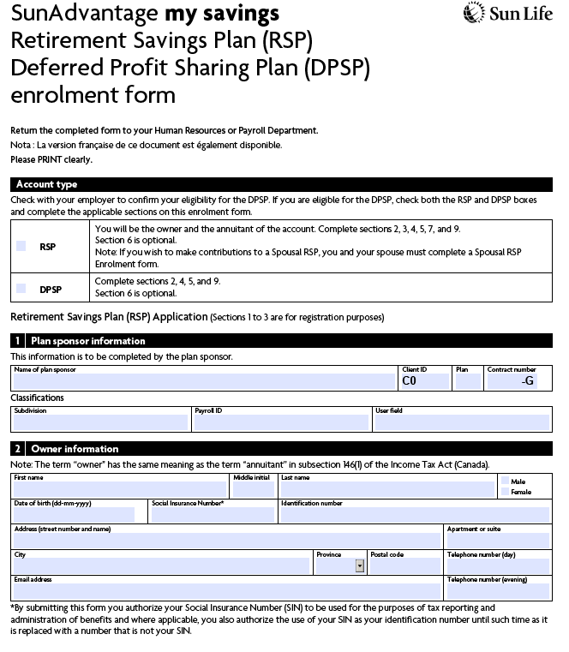
How do I get started?
Notes:
First, we will look at how to enrol in the RRSP and DPSP.
Select an account type: Do this by checking off the product(s) that you wish to enrol in. This is either an RSP and/or a DPSP. If you wish to make contributions to a Spousal RSP account, you and your spouse must complete a Spousal RSP Enrolment form. A Spousal RRSP, is where you are the contributor, but your spouse or partner is the owner or annuitant.
In section 1 – Enter in your company name, and your company’s client id, plan number assigned by Sun Life (if your plan is brand new these numbers may not be available, otherwise your employer can provide this information).
For section 2 – This is where you will enter your name, address and Social Insurance Number.

Slide 27
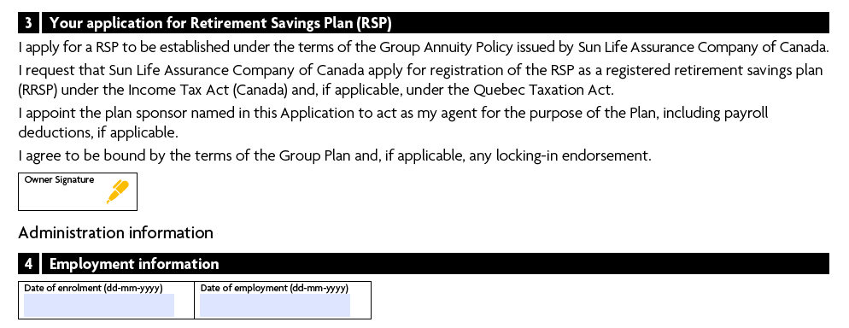
How do I get started?
Notes:
Section 3 is where you sign to apply for the RRSP.
In section 4, enter your date of enrolment and date of employment.

Slide 28
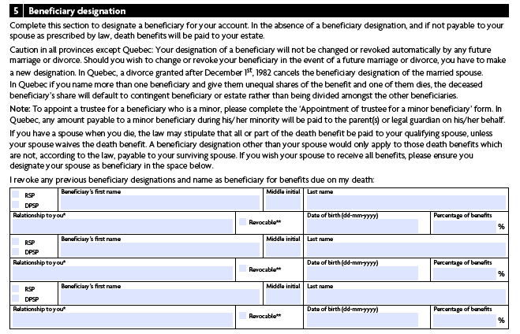
How do I get started?
Notes:
Section 5 is where you may assign a beneficiary. If you don’t complete this section, the account beneficiary will be defaulted to your estate. Beneficiaries can be changed online via mysunlife.ca at any time. It is up to you to let Sun Life know if you would like to change your beneficiary information.
You may also assign a contingent or secondary beneficiary in Section 6 . This is the beneficiary that would apply if the beneficiary you identified in Section 5 predeceases you.

Slide 29
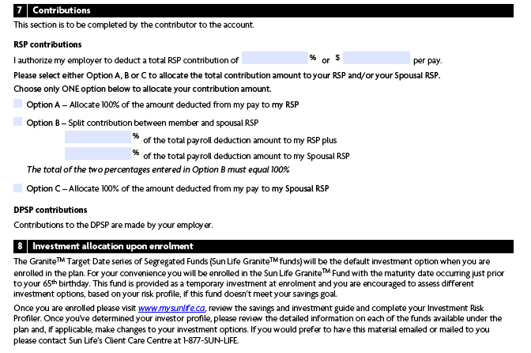
How do I get started?
Notes:
In Section 7 you will authorize your employer to deduct a percentage or dollar amount from your pay. This amount will be remitted every pay cycle to Sun Life. To update or change the amount, you will need to contact the payroll person in your organization. Choose from one of three options: either split the contributions between your account and your spousal account; allocate 100% to your spousal account; or allocate 100% to your account.

Slide 30
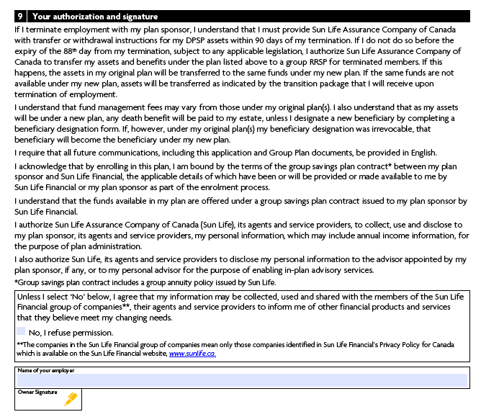
How do I get started?
ABC Company
Notes:
For Section 9 read the authorization statement, include the name of your plan sponsor (or employer), and sign and date the enrolment form. Give the completed form to your payroll or HR contact. In 5 to 10 business days, Sun Life will send you an Access ID and password for mysunlife.ca. You will be able to go online and change your investment selection, or contact the Sun Life Client Care Center and change your selection over the phone.
Congratulations, you are now enrolled in the Sun Advantage my savings RRSP and DPSP!

Slide 31
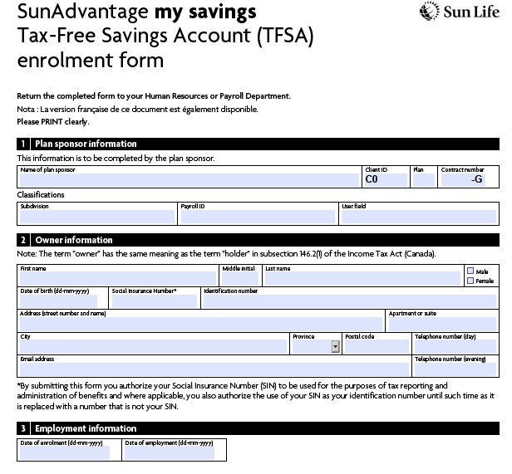
How do I get started?
Completion of the
TFSA enrolment form
is necessary if you
would like to
contribute to the
Tax-Free Savings Account
Notes:
If you are interested in enrolling in the TFSA, the steps will be similar to the RSP/DPSP enrolment form. There is one key difference however. Contributions will not be made via payroll deduction, but are done through a direct debit from your chequing account. You will be asked to provide chequing account information on the application form.
Give the completed form, and a copy of a cheque marked VOID to your payroll or HR contact.
You will be able to go online and make an investment selection or contact the Sun Life Client Care Centre and make a selection over the phone for your SunAdvantage TFSA as well.

Slide 32
Your future is waiting… enrol today
Group Retirement Services are provided by Sun Life Assurance Company of Canada, a member of the Sun Life group of companies. © Sun Life Assurance Company of Canada, 2023.
Notes:
Thank you once again for taking some time to learn about the retirement plan that is being offered to you through Sun Life and your employer. Enrol today, to begin saving for your future.

